Slide 1
FONT RECOGNITION
SYSTEM
ENGLISH
CBIVR - CSE3018
UTKARSH - 19BCE1631
KOWSHAL - 19BCE1396

Slide 2
CONTENTS
01.
ABSTRACT
02.
MODULES
A brief introduction to the idea
The different modules used to make this project
03.
METHODOLOGY
04.
REQUIREMENTS
The process and steps to be followed
The hardware and software requirements

Slide 3
ABSTRACT

Slide 4
Various techniques have been developed to extract text successfully from images, the most famous being OCR.
This project on font detection is intended to benefit various creators that need to identify fonts suggestions from images or posters.
Automatic font identification and similar font suggestion from an image or photo has been on the wish list of many designers.
We want to take a step further to exploit the usage of OCR to predict the font used in images using deep learning techniques with python.
We are centered around programming the profound textual style acknowledgment proposed by Adobe on a particular dataset named Adobe VFR and the strategy utilized is a profound learning model to prepare a model dependent on the dataset and test it.
We are making a custom dataset dependent on Adobe's VFR dataset.
ABSTRACT

Slide 5
MODULES

Slide 6
MODULES
01.
02.
Image Processing
Dataset Selection
Process the query image using functions like pil_image, noise_image, blur_image and affine_image so that the image is suitable to be queried
We are centered around programming the profound textual style acknowledgment proposed by Adobe on a particular dataset named Adobe VFR.
03.
04.
Train the Model
Compile the Model
The strategy utilized is a profound learning model to prepare a model dependent on the dataset and test it.
Use the query image for the dataset, to find the font used in the query image based on the model.

Slide 7
METHODOLOGY

Slide 8
Compose a python content to peruse the dataset and train the model utilizing profound learning, 75% of the dataset is utilized for preparing, and the rest 25% is utilized for testing.
Commotion, obscure, and point of view revolution are applied to more readily dissect pictures for textual style acknowledgment.
The technique utilized for this venture for textual style acknowledgment has significantly three stages.
Stage one is to get an information picture to be handled which is promptly pre handled and afterward sent for other element calculation in second step.
The proposed framework for textual style acknowledgment and order framework fundamentally includes three primary stages. In stage 1, an info picture is obtained for handling and continued for pre-handling and further coordinated for highlight calculation in stage two.
At last, the highlights processed are characterized through a SVM classifier. Fig 1 portrays the square chart of the proposed framework.
METHODOLOGY

Slide 9
REQUIREMENTS

Slide 10
What do we offer ?
Jupyter Notebook for running the modules code and train the model
Adobe VFR Dataset for the model to train on
Query image containing the font you know
A better hardware to train the model (non-functional requirement)

Slide 11

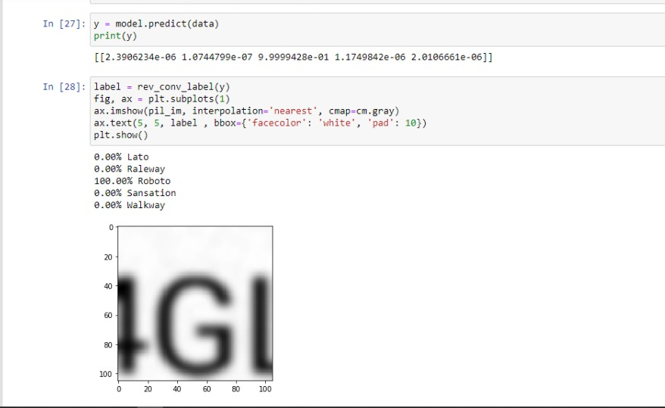
DEMO

Slide 12
THANK YOU!

